Slide 1
COVID-19 Mortality Excess and Cost-Effective Analysis of Different Treatments

Slide 2
Objective
The aims of this analysis are twofold:
To estimate the COVID-19 specific mortality for the population over 45 years of age in Mexico using relative survival methods.
Quantify the costs, effectiveness and cost-effectiveness using a microsimulation model of different treatments that aim to reduce the COVID-19-specific mortality.

Slide 3
Data
We used data from the National Epidemiological Surveillance System base for monitoring possible cases of COVID-19 (Public data bases by Mexico’s Ministry of health).
We classify these patients by sex, age group, and whether they were intubated.
Age groups: 45 – 54, 55 – 64, 65 – 69, 70 +.

Slide 4
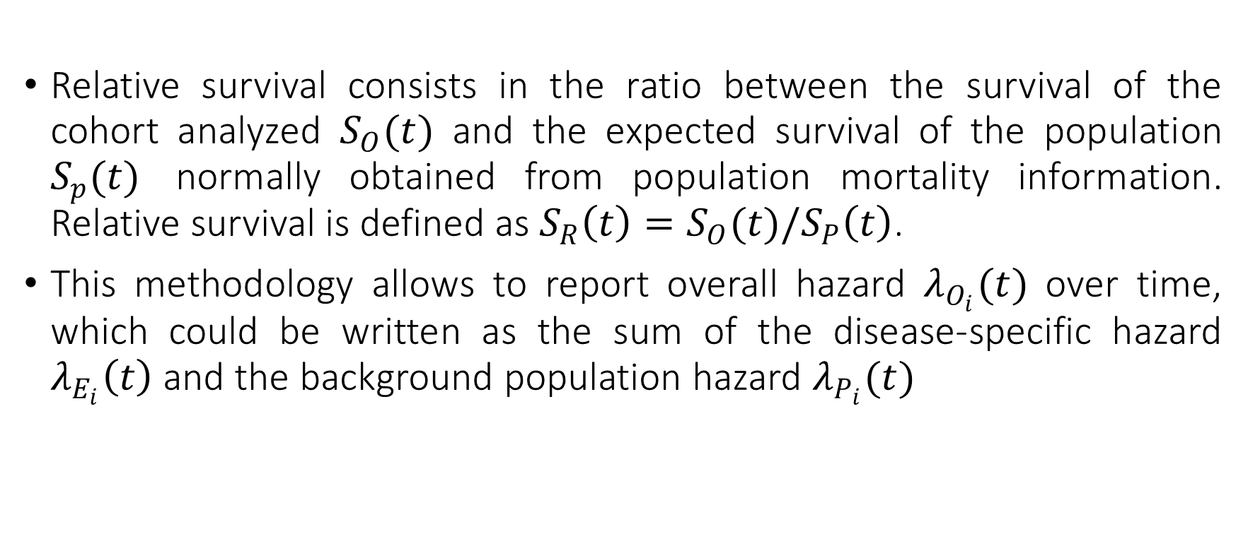
Relative Risk
Relative survival consists in the ratio between the survival of the cohort analyzed $S_{O}(t)$ and the expected survival of the population $S_{p}(t)$ normally obtained from population mortality information. Relative survival is defined as $S_{R}\left(t\right)=S_{O}(t)/S_{P}\left(t\right)$.
This methodology allows to report overall hazard $λ_{O_{i}}(t)$ over time, which could be written as the sum of the disease-specific hazard $λ_{E_{i}}\left(t\right)$ and the background population hazard $λ_{P_{i}}(t)$

Slide 5
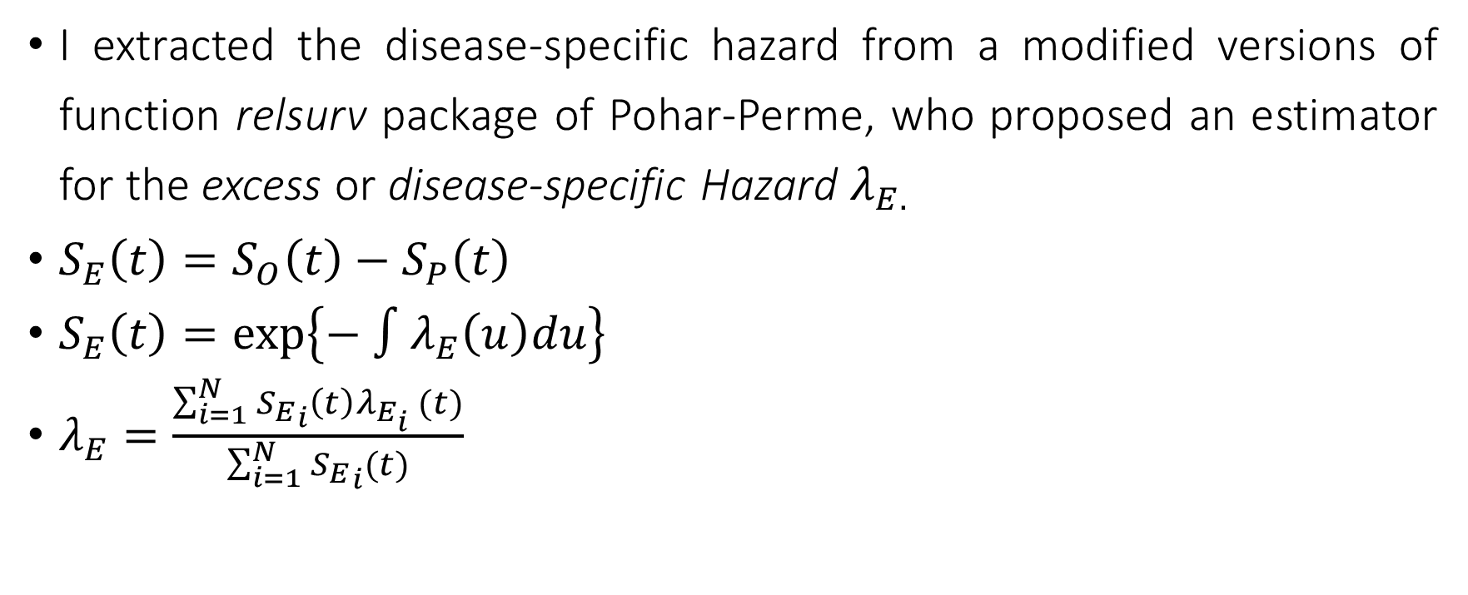
Disease-specific Hazard
I extracted the disease-specific hazard from a modified versions of function relsurv package of Pohar-Perme, who proposed an estimator for the excess or disease-specific Hazard $λ_{E.}$
$S_{E}\left(t\right)=S_{O}\left(t\right)−S_{P}\left(t\right)$
$S_{E}\left(t\right)=exp\left\{− ∫λ_{E}\left(u\right)du\right\}$
$λ_{E}=\frac{\sum_{i=1}^{N}{{S_{E}}_{i}\left(t\right)λ_{E_{i}} (t)}}{\sum_{i=1}^{N}{{S_{E}}_{i}(t)}}$

Slide 6
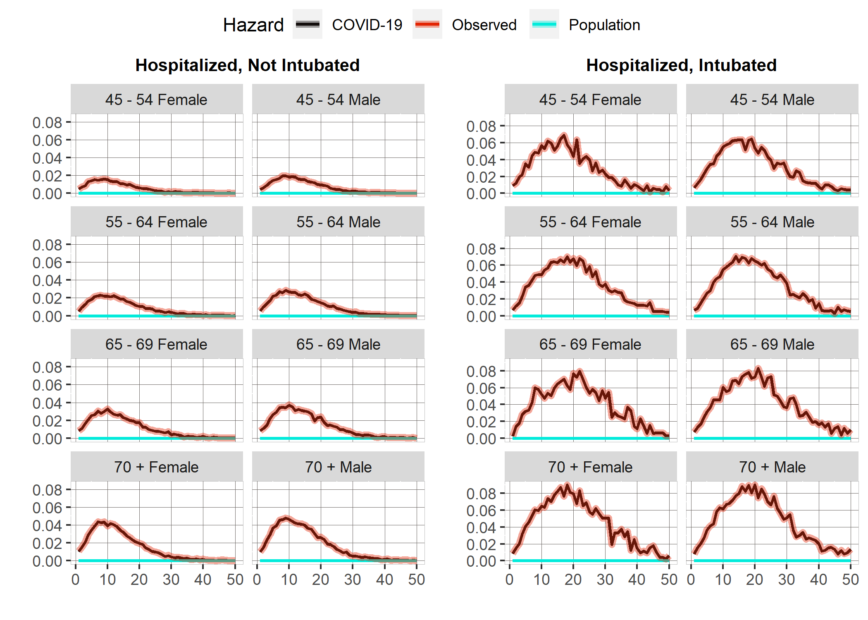
COVID-19 Specific Hazard

Slide 7
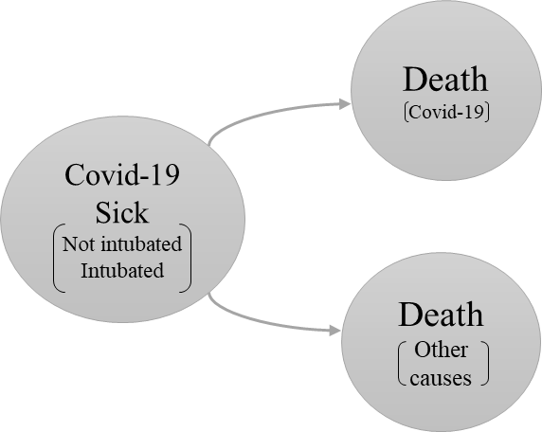
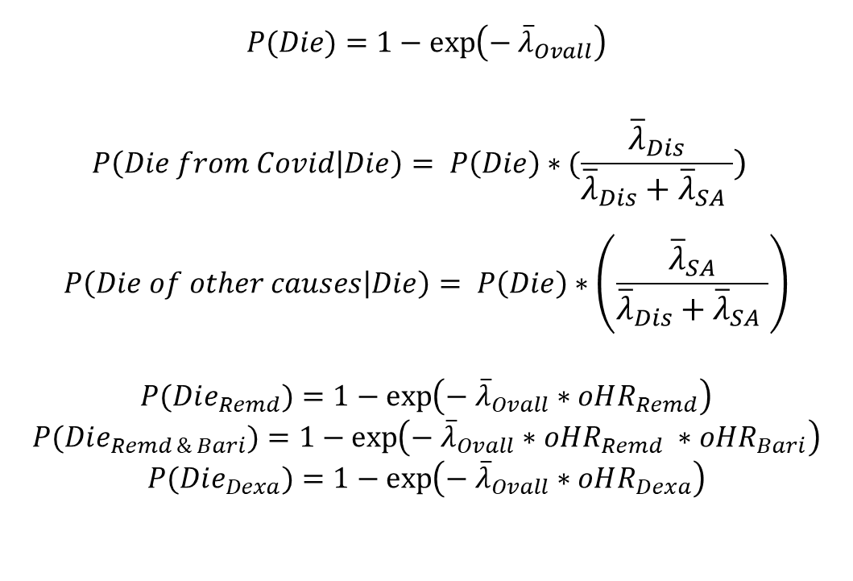
Model
$$P(Die)=1−\exp\left(− {\overline{λ}}_{Ovall}\right)$$
$$P\left(Die from Covid | Die\right)= P\left(Die\right)∗(\frac{{\overline{λ}}_{Dis}}{{\overline{λ}}_{Dis}+{\overline{λ}}_{SA} })$$
$$P\left(Die of other causes | Die\right)= P\left(Die\right)∗\left(\frac{{\overline{λ}}_{SA}}{{\overline{λ}}_{Dis}+{\overline{λ}}_{SA} }\right)$$
$$P(Die_{Remd})=1−\exp\left(− {\overline{λ}}_{Ovall}∗oHR_{Remd}\right)$$
$$P(Die_{Remd \& Bari})=1−\exp\left(− {\overline{λ}}_{Ovall}∗oHR_{Remd} ∗oHR_{Bari}\right)$$
$$P(Die_{Dexa})=1−\exp\left(− {\overline{λ}}_{Ovall}∗oHR_{Dexa}\right)$$

Slide 8
Cost-Effectiveness Analysis
Because Dexamethasone is not recommended for non-intubated patients and Remdesivir is a drug that has shown more efficacy in less critical states, the simulated population was divided into two cohorts Patients who were hospitalized without intubation and patients who were hospitalized and intubated.
Patients hospitalized without intubation
Treat with Remdesivir
Treat with Remdesivir and Baricitinib
No treatment
Patients hospitalized and intubated
Treat with Dexamethasone
No treatment

Slide 9
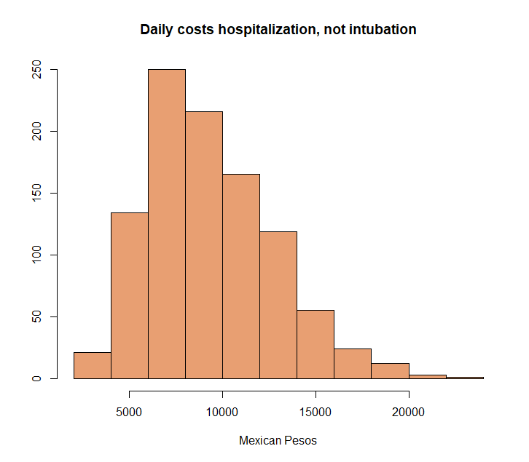
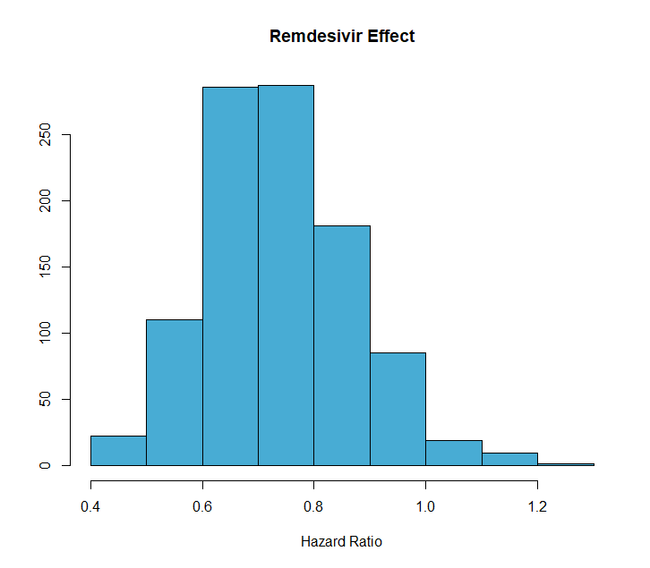
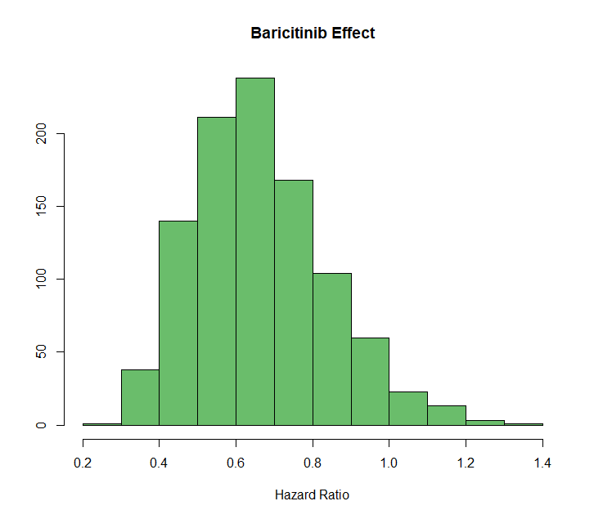
Parameters Hospitalized, not Intubated
Table 1: Parameter microsimulation model: Hospitalized, not Intubated Cohort
Parameters | Value
Number of individuals | 200,693
Time horizon | 50 days
Number of states | 3
Name of states | Cov-19 +
 | Cov-19 Dead
 | Other causes Dead
Annual discount rate for costs | 0.0165
Annual discount rate for efectiveness | 0.0165
Daily healthcare costs
Hospitalized COVID-19 patient | Gamma distribution: ꓗ = 8, θ = 1159
Dead patient | 0
Intervention daily costs
Remdesivir | $6,188.00
Baricitinib | $3,672.00
Intervention Effect
Remdesivir | Lognormal distribution: μ = 0.73, σ = 0.17
Baricitinib | Lognormal distribution: μ = 0.65, σ = 0.26
*All monetary amounts are expressed in Mexican pesos

Slide 10
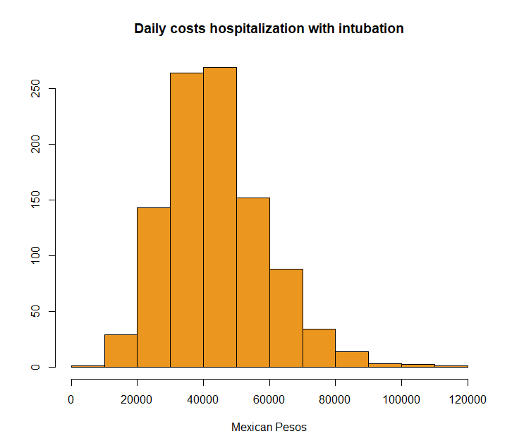
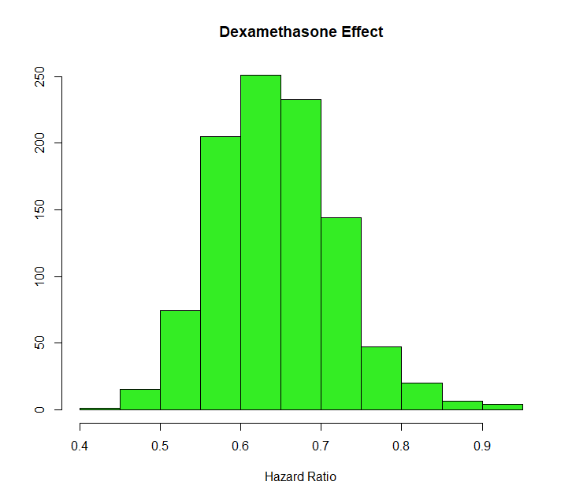
Parameters Hospitalized, Intubated
Table 2: Parameter microsimulation model: Hospitalized, Intubated Cohort
Parameters | Value
Number of individuals | 38,884
Time horizon | 50 days
Number of states | 3
Name of states | Cov-19 +
 | Cov-19 Dead
 | Other causes Dead
Annual discount rate for costs | 0.0165
Annual discount rate for efectiveness | 0.0165
Daily healthcare costs
Intubated COVID-19 patient | Gamma distribution: ꓗ = 8, θ = 5518.87
Dead patient | 0
Intervention daily costs
Dexamethasone | $4
Intervention Effect
Dexamethasone | Lognormal distribution: μ = 0.64, σ = 0.11
*All monetary amounts are expressed in Mexican pesos

Slide 11
Limitations
One of the limitations of this work is that the model considers that individuals classified as sick during all cycles are hospitalized, when it is possible that they have already been discharged.

Slide 12
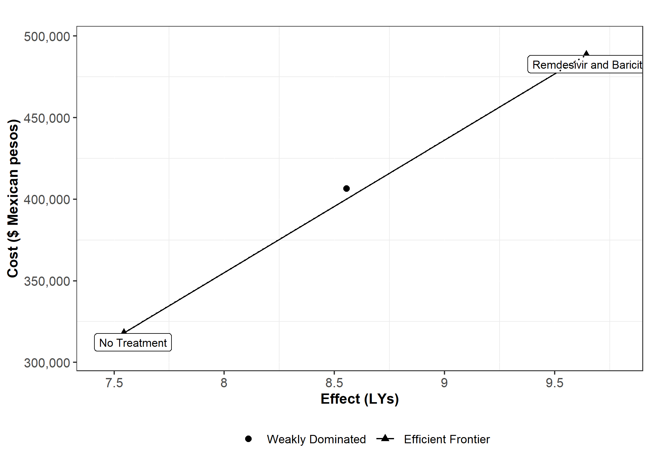
Cost-Effectiveness Analysis: Hospitalized, not Intubated
Willingness to Pay Threshold for Mexico: Two GDP Per Capita per QALY.
$439,613.2 Mexican Pesos
Cost-Effectiveness Analysis: Hospitalized, not Intubated (Disease-specific)
Strategy | Cost | Effect | Incremental Cost | Incremental Effect | ICER
No Treatment | $317,933 | 7.54 | - | - | -
Remdesivir and Baricitinib | $488,107 | 9.62 | $170,174 | 2.087208 | 81532
Remdesivir | $406,372 | 8.54 | - | - | -
Cost Effectiveness Analysis: Hospitalized, not Intubated (Overall)
Strategy | Cost | Effect | Incremental Cost | Incremental Effect | ICER
No Treatment | $317,981 | 7.54 | - | - | -
Remdesivir and Baricitinib | $488,465 | 9.64 | $170,484 | 2.09 | 81206
Remdesivir | $406,506 | 8.55 | - | - | -

Slide 13
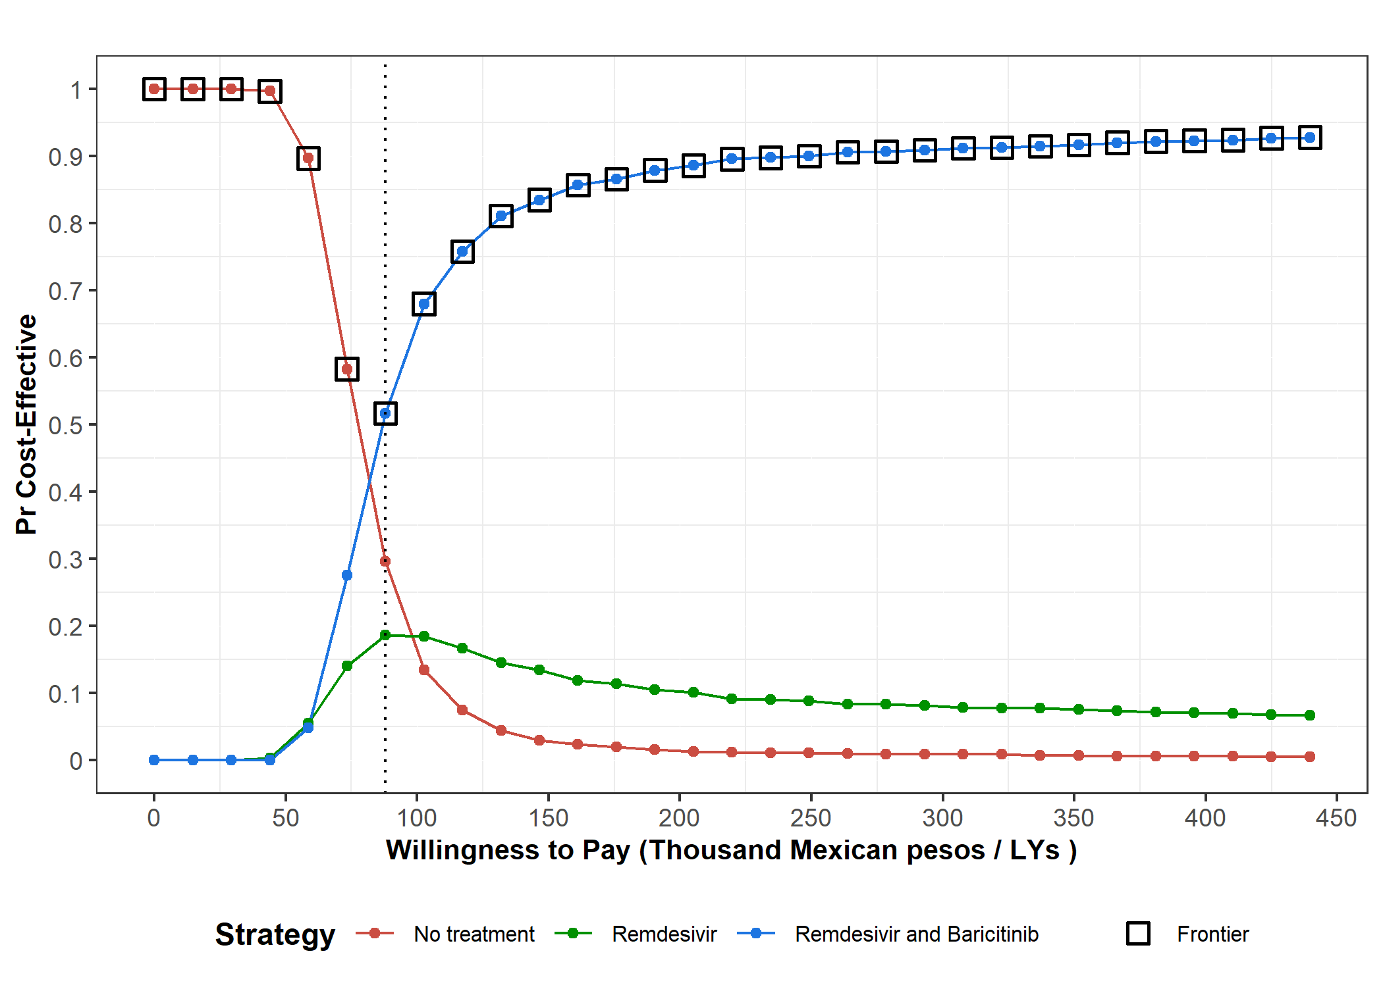
Cost-Effectiveness Analysis: Hospitalized, not Intubated
CEAC
Range No Treatment: 0 – 87,922
Range Dexamethasone: 87,922 – 439,613

Slide 14
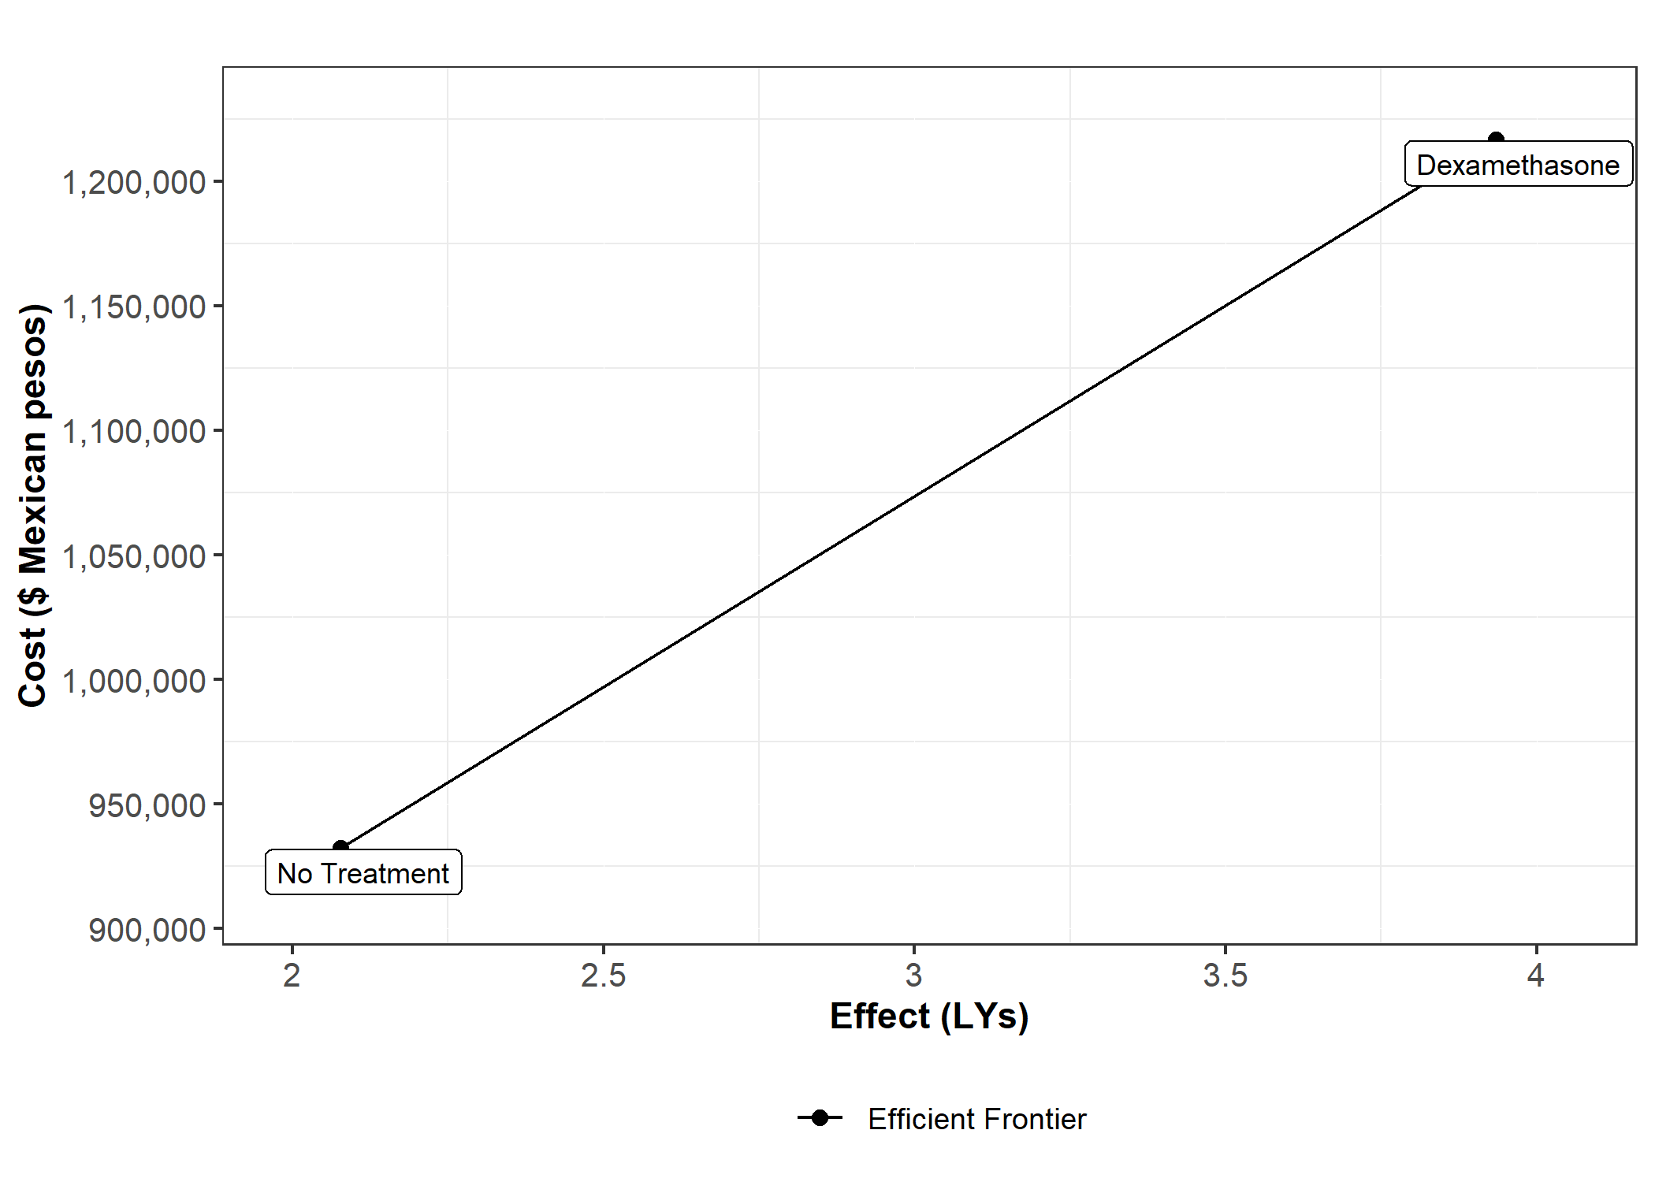
Cost-Effectiveness Analysis: Hospitalized, Intubated
The expected Life Years gained by dexamethasone are 1.8. The vast majority of dexamethasone costs come from the increase in individuals who survived the treatment and who saw their hospital costs increase. The price of the drug is meager (approximately 4 Mexican pesos).
Cost Effectiveness Analysis: Hospitalized, Intubated (Disease-specific)
Strategy | Cost | Effect | Incremental Cost | Incremental Effect | ICER
No Treatment | $923,677 | 2.07726 | - | - | -
Dexamethasone | $1,200,217 | 3.898768 | $276,539 | 1.821508 | $151818
Cost Effectiveness Analysis: Intubated, Intubated (Overall)
Strategy | Cost | Effect | Incremental Cost | Incremental Effect | ICER
No Treatment | $932,219 | 2.0773 | - | - | -
Dexamethasone | $1,216,627 | 3.9342 | $284,408.00 | 1.85694 | $153,159

Slide 15
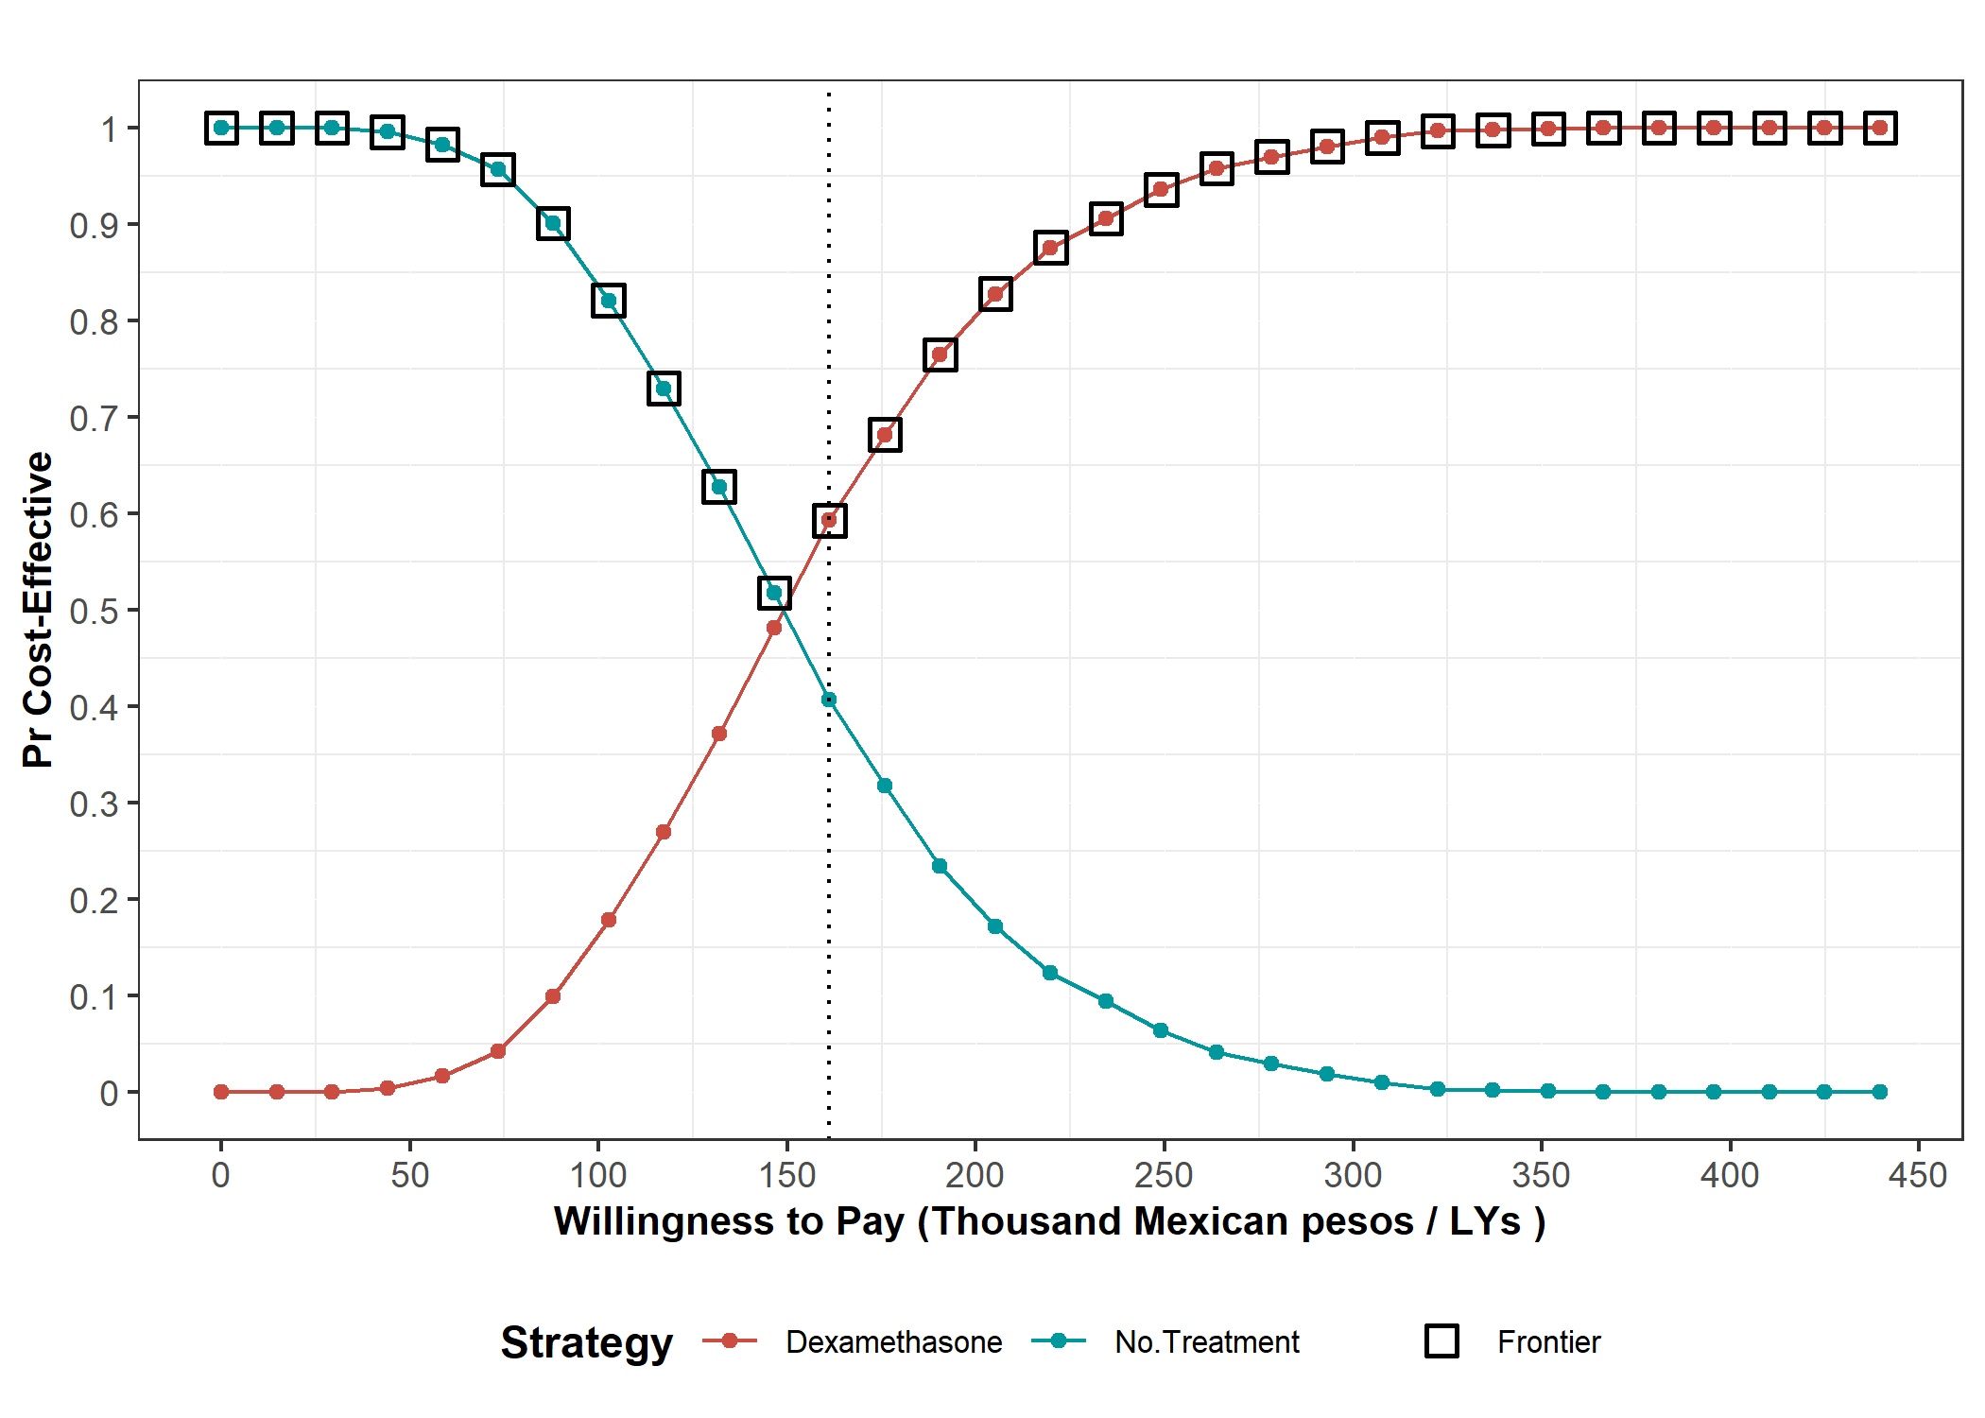
Cost-Effectiveness Analysis: Hospitalized, Intubated
CEAC
Range No Treatment: 0 – 161,192
Range Dexamethasone: 161,192 – 439,613

